Slide 1
Navigation
Developer's guide to
Windows 10 Insider Preview
Andy & Jerry

Slide 2
Layout
Navigation

Slide 3
Layout

Slide 4
Minimum size
ApplicationView .GetForCurrentView() TryResizeView(new size(width, height)))
Check return value (Boolean)

Slide 5
Resize
ApplicationView .GetForCurrentView() SetPreferredMinSize(new size(width, height)))
Check return value (ENUM)

Slide 6
Understanding immersive mode
Non-resizable, mobile SKU
Limited sizing options
Full screen mode
Developer can now request Full Screen
Developer can now test Full Screen

Slide 7
Windowing
Windows.ApplicationModel.Core .CoreApplication.CreateNewView()
Windows.UI.ViewManagement .ApplicationViewSwitcher.SwitchAsync()
Windows.UI.ViewManagement .ApplicationViewSwitcher .TryShowAsStandaloneAsync()
Available across all of Windows 10
New view must call Window.Activate()

Slide 8
Multi-view on launch
Windows.UI.ViewManagement .ApplicationViewSwitcher .DisableSystemViewActivationPolicy()
Opt-in to the activation policy
ApplicationViewSwitcher .DisableShowingMainViewOnActivation()
Prevent flicker on launch

Slide 9
Navigation

Slide 10
Frame.Navigate
Send to a type
Pass a string
Navigation service
Part of Template 10 project template
private void Goto2(object sender, Windows.UI.Xaml.RoutedEventArgs e)
{
var app = App.Current as Common.BootStrapper;
var nav = app.NavigationService;
nav.Navigate(typeof(Views.Page2), "My marameter value");
}

Slide 11
Navigation parameters
Page.OnNavigatedTo()
Standard in Windows
ViewModel.OnNavigatedTo
With Template 10 project template
public override void OnNavigatedTo(string parameter,
NavigationMode mode, IDictionary<string, object> state)
{
this.Parameter = parameter?.ToString() ?? "Empty";
}

Slide 12
Navigation parameters

Slide 13
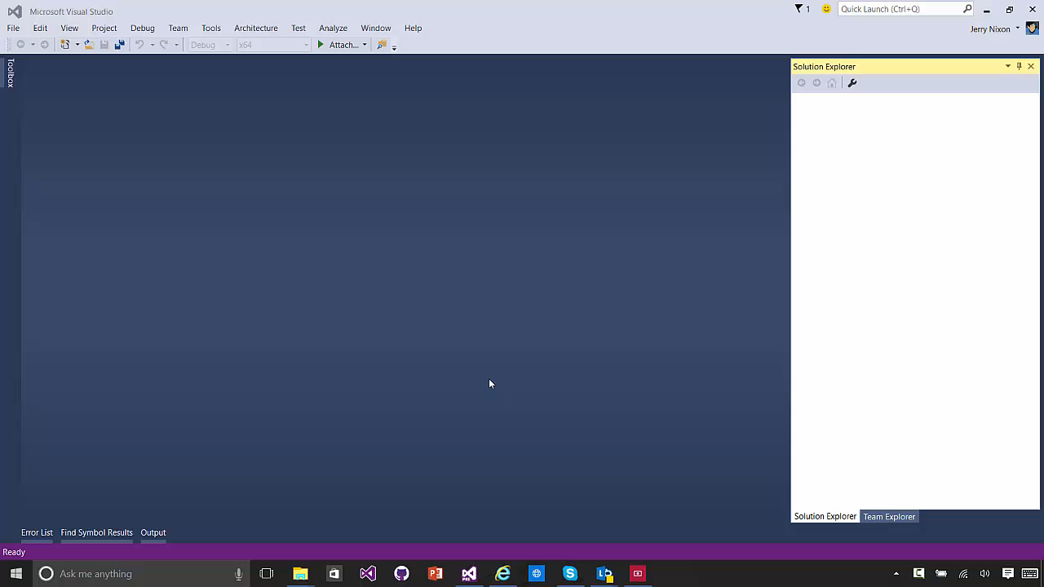

Slide 14
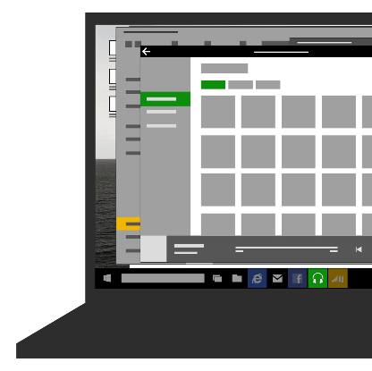
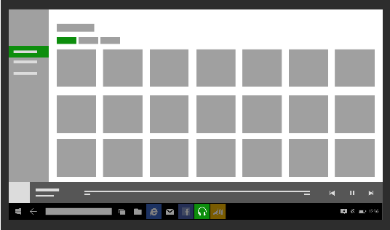
Opt-in, shell-drawn back button

Slide 15
Back button
Essentially same as Phone 8.1
Back navigates back within app, then to previous app
UAP apps request the optional, shell-drawn back button
With one improvement
Backing out does not close the app
And, a new scenario for tablet
In split screen, there is a [back stack] for each side of the screen
Windows.UI.ViewManagement.ApplicationView.GetForCurrentView().IsShellChromeBackEnabled = true;
Windows.UI.Core.SystemNavigationManager.GetForCurrentView().BackRequested += HandleBack;

Slide 16
Back support
Support gestures
Windows + backspace
Hardware back button
Keyboard back button
Mouse back button
(Template 10)
Opt-in to back in Windowed mode
Automatic in immersive
Some guidance
Don’t strand users
Don’t hijack back

Slide 17
Layout
Navigation

